Slide 1

Data Modeling Using the
Entity-Relationship (ER) Model

Slide 2
ER Model Concepts
Entity Types, Value Sets, and Key Attributes
Relationships and Relationship Types
Weak Entity Types
2

Slide 3
Entity Types and Entity Set
3

Slide 4
Entity Types
A database usually contains groups of entities that are similar.
For example, a company employing hundreds of employees may want to store similar information concerning each of the employees.
These employee entities share the same attributes, but each entity has its own value(s) for each attribute.
An entity type defines a collection of entities that have the same attributes.
Each entity type in the database is described by its name and attributes.
4

Slide 5
Entity Set
The collection of all entities of a particular entity type in the database at any point in time is called an entity set or entity collection;
The entity set is usually referred to using the same name as the entity type, even though they are two separate concepts.
5

Slide 6
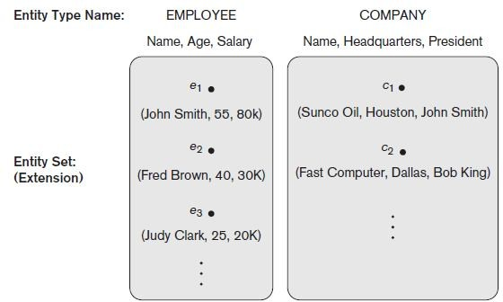
Example
6

Slide 7
Entity Type vs Entity Set
An entity type describes the schema or intension for a set of entities that share the same structure.
The collection of entities of a particular entity type is grouped into an entity set, which is also called the extension of the entity type.
7

Slide 8

Key Attributes of an Entity Type
An attribute of an entity type for which each entity must have a unique value is called a key attribute of the entity type.
For example, SSN of EMPLOYEE.
Constraint
Composite key (next slide)
No Key – Weak Entity type
8

Slide 9
Key Attributes of an Entity Type
A key attribute may be composite.
VehicleTagNumber is a key of the CAR entity type with components (Number, State).
An entity type may have more than one key.
The CAR entity type may have two keys:
VehicleIdentificationNumber (popularly called VIN)
VehicleTagNumber (Number, State), aka license plate number.
Each key is underlined
9

Slide 10
Notations Summary
In ER diagrams,
an entity type is displayed in a rectangular box
Attributes are displayed in ovals
Each attribute is connected to its entity type
Components of a composite attribute are connected to the oval representing the composite attribute
Each key attribute is underlined
Multivalued attributes displayed in double ovals
See CAR example on next slide

Slide 11
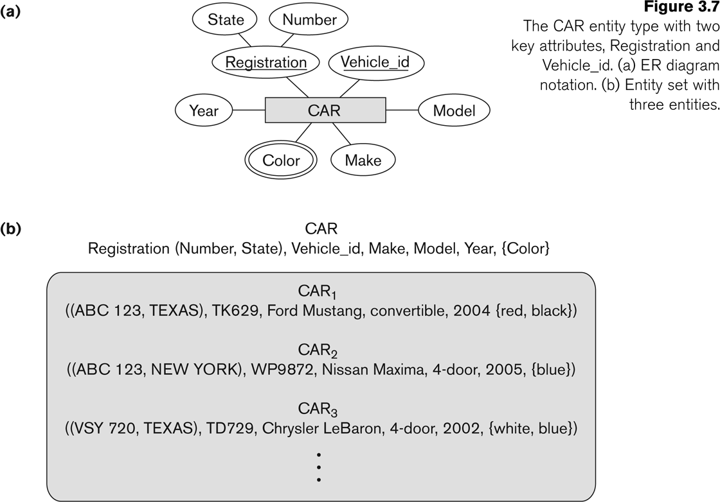
Entity Type CAR with two keys and a corresponding Entity Set

Slide 12
Value Sets (Domains) of Attributes
Each simple attribute of an entity type
Associated with a value set (or domain of values)
Specifies the set of values that may be assigned to that attribute for each individual entity.
Age – 15-79
Names – alphabets,spaces

Slide 13
Value Sets (Domains) of Attributes
Value sets are not typically displayed in basic ER diagrams
Specified using the -
programming languages
Integer
String
Boolean
Float
enumerated type
subrange.
data types available in most

Slide 14
Value Sets (Domains) of Attributes
Mathematically
An attribute A of entity set E whose value set is V can be defined as
a function from E to the power set P(V) of V:
A : E → P(V)

Slide 15
Initial Design of Entity Types for the COMPANY
Database Schema
Based on the requirements,
we can identify four initial entity types in the COMPANY database:
DEPARTMENT
PROJECT
EMPLOYEE
DEPENDENT
Their initial design is shown on the following slide
The initial attributes shown are derived requirements description
from the

Slide 16
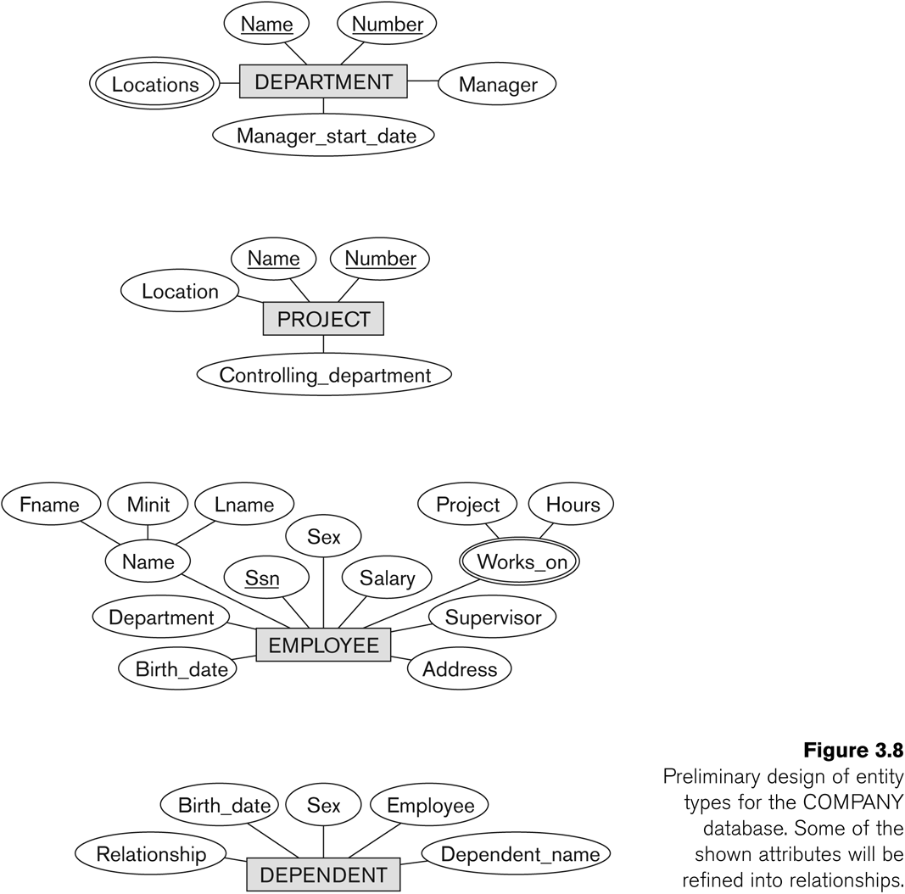
Initial Design of Entity Types: EMPLOYEE, DEPARTMENT, PROJECT, DEPENDENT

Slide 17
Relationship Types, Relationship Sets, Roles, and Structural Constraints

Slide 18
Refining the initial design by introducing
Relationships
The initial design is typically not complete
Some aspects in the requirements will be represented as
relationships
ER model has three main concepts:
Entities (and their entity types and entity sets)
Attributes (simple, composite, multivalued)
Relationships (and their relationship types and relationship sets)
We introduce relationship concepts next

Slide 19
Relationships and Relationship Types
A relationship relates two or more distinct entities with a specific meaning.
For example
EMPLOYEE John Smith works on the ProductX PROJECT,
EMPLOYEE Franklin Wong manages the Research DEPARTMENT.
Employee
Works_ on
Project

Slide 20
Relationships and Relationship Types
Relationships of the same type are grouped into a
relationship type.
For example
the WORKS_ON relationship type in which EMPLOYEEs and PROJECTs participate
the MANAGES relationship type in which EMPLOYEEs and DEPARTMENTs participate.
Employee
Works_ on
Project

Slide 21
Degree of a Relationship Type
The degree of a relationship type is the number of participating entity types.
Both MANAGES and WORKS_ON are binary relationships.
Employee
manages
Department

Slide 22
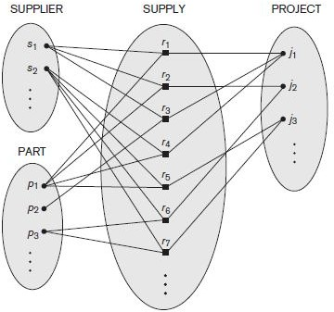
Ternary Relationship

Slide 23
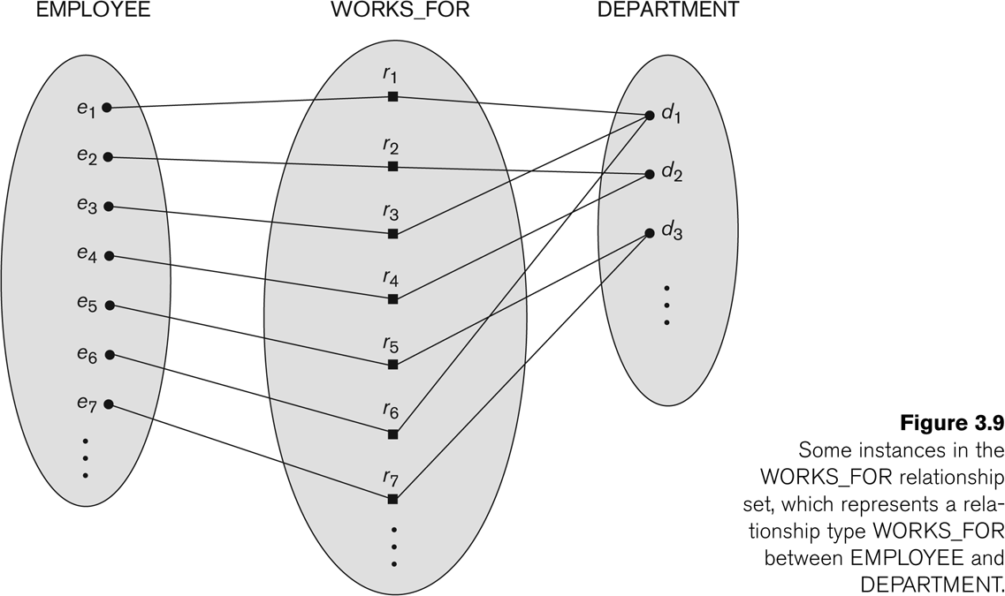
Relationship instances of the WORKS_FOR N:1 relationship between EMPLOYEE and DEPARTMENT

Slide 24
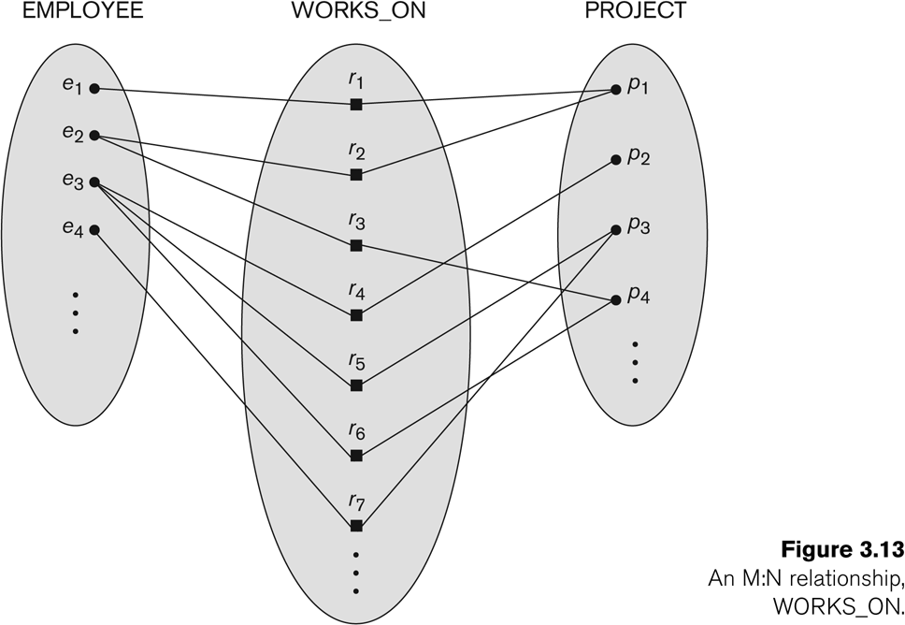
Relationship instances of the M:N WORKS_ON relationship between EMPLOYEE and PROJECT

Slide 25
Relationship type vs. relationship set (1)
Relationship Type:
Is the schema description
Identifies the relationship name and the participating entity types
Also identifies certain relationship constraints
Relationship Set:
The current set of relationship instances represented in the database
The current state of a relationship type

Slide 26
Relationship type vs. relationship set (2)
Each instance in the set relates individual participating entities – one from each participating entity type
In ER diagrams, we represent the relationship type as follows:
Diamond-shaped box is used to display a relationship type
Connected to the participating entity types via straight lines

Slide 27
Refining the COMPANY database schema by
introducing relationships
By examining the requirements, six relationship types are identified
All are binary relationships( degree 2)
Listed below with their participating entity types:
WORKS_FOR (between EMPLOYEE, DEPARTMENT)
MANAGES (also between EMPLOYEE, DEPARTMENT)
CONTROLS (between DEPARTMENT, PROJECT)
WORKS_ON (between EMPLOYEE, PROJECT)
SUPERVISION (between EMPLOYEE (as subordinate), EMPLOYEE (as supervisor))
DEPENDENTS_OF (between EMPLOYEE, DEPENDENT)

Slide 28
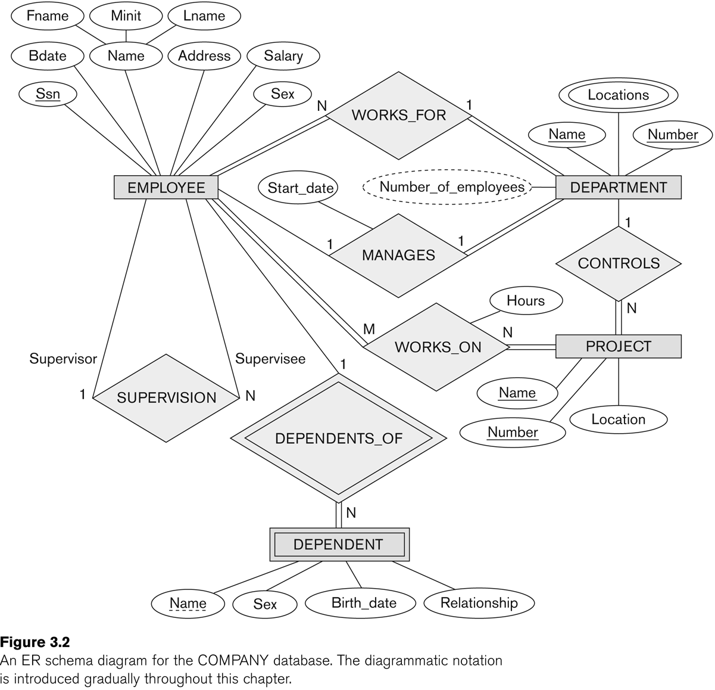
ER DIAGRAM – Relationship Types are:
WORKS_FOR, MANAGES, WORKS_ON, CONTROLS, SUPERVISION, DEPENDENTS_OF

Slide 29
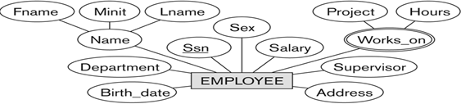
Discussion on Relationship Types
In the refined design, some attributes from the initial entity types are refined into relationships:
Manager of DEPARTMENT -> MANAGES
Works_on of EMPLOYEE -> WORKS_ON
Department of EMPLOYEE -> WORKS_FOR
In general, more than one relationship type can exist between the same participating entity types
MANAGES and WORKS_FOR are distinct relationship types between EMPLOYEE and DEPARTMENT
Different meanings and different relationship instances.

Slide 30
Recursive Relationship Type

Slide 31
Recursive Relationship Type
An relationship type - with the same participating entity type in distinct roles
Example: the SUPERVISION relationship
EMPLOYEE participates twice in two distinct roles:
supervisor (or boss) role
supervisee (or subordinate) role
Each relationship instance relates two distinct EMPLOYEE entities:
One employee in supervisor role
One employee in supervisee role

Slide 32
Displaying a recursive relationship
In following figure (next slide),
first role participation labeled with 1 and
second role participation labeled with 2.
In ER diagram
need to display role names to distinguish participations.

Slide 33
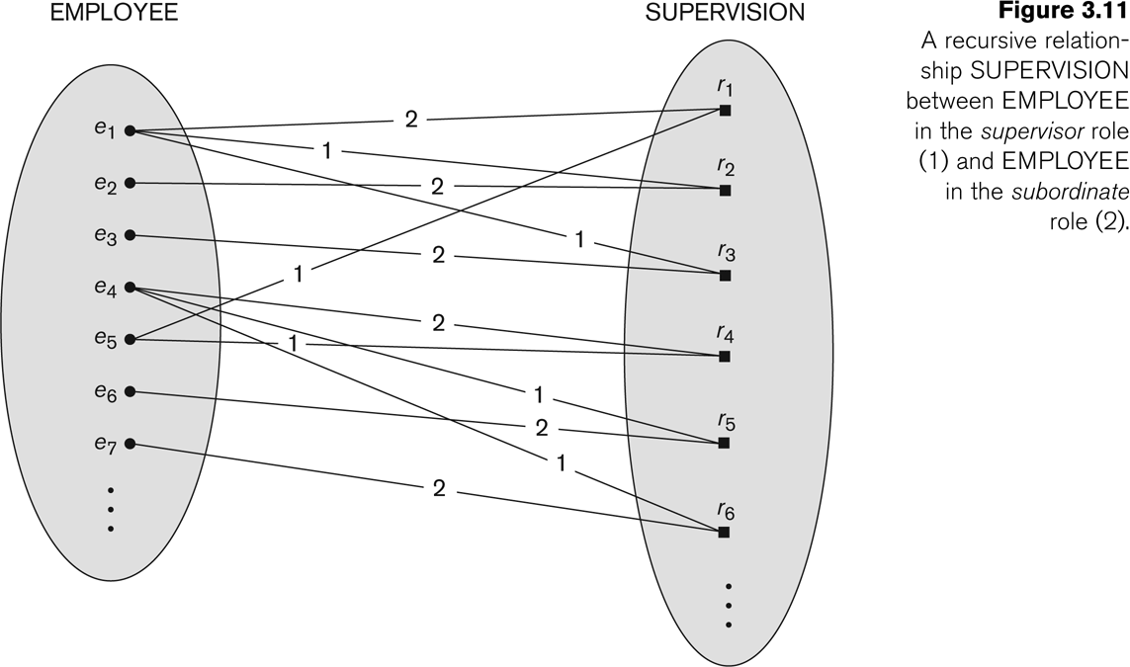
A Recursive Relationship Supervision`

Slide 34

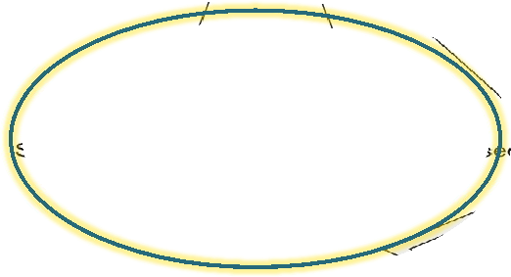
Recursive Relationship Type is: SUPERVISION
(participation role names are shown)

Slide 35
Weak Entity Types

Slide 36
Weak Entity Types
An entity that does not have a key attribute
A weak entity must participate in an identifying relationship type with an
owner or identifying entity type
Entities are identified by the combination of:
A partial key of the weak entity type
The particular entity they are related to in the identifying entity type
Example:
A DEPENDENT entity is identified by the dependent’s first name, and
the specific EMPLOYEE with whom the dependent is related
Name of DEPENDENT is the partial key
DEPENDENT is a weak entity type
EMPLOYEE is its identifying entity type via the identifying relationship type DEPENDENT_OF

Slide 37

Entity Types
Entity Set
Relationship Types
Relationship Sets
Structural Constraints
Recursive Relationship Type
Weak Entity Types

Slide 38


